Slide 1
Fitness Challenge Tracker
BitsPlease
Kyla Bouldin, Evan Clark, Pallavi Kalva, Matt LeDonne

Slide 2
Introduction
Program Details
Day 1 – Implementer Side
Day 2 – Client Side & Demo

Slide 3
Program Details
Helps document and track physical activity, body measurements, and nutritional information
Allows user to set goals they would like to achieve
Makes it easier to analyze how the user responds to their lifestyle

Slide 4
Day 1 – Implementer Side
Technologies
Ruby on Rails
Foundation
Devise
ChartKick
SimpleCalendar
Architecture & Models

Slide 5



Ruby on Rails & Foundation
$ rails new fitness_tracker $ cd fitness_tracker $ echo “gem ‘foundation-rails’ >> Gemfile $ bundle install $ rails g foundation:install
Notes:
Easy to install framework with ruby on rails. Used to create navigation bar, form formatting, and buttons
5

Slide 6
Devise
Flexible authentication solution for Rails
Automatically creates user controller and login/signup views
Password encryption
Sessions
$ gem 'devise’ $ bundle install $ rails g devise:install $ rails g devise user $ rake db:migrate $ rails g devise:views
Notes:
Easy to install devise with rails. Used to create user model; devise automatically creates user controller and login/signup views
Passwords are encrypted upon sign up and sessions are created to keep use logged in on log in page
6

Slide 7
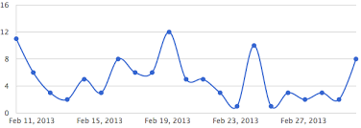
ChartKick
Charting library for Ruby on Rails to make nice looking charts
Compatible with all major browsers
Created dynamic, interactive charts
<%= line_chart User.group_by_day(:crated_at).count %>

Slide 8
SimpleCalendar
Gem used to render a calendar
Uses HTML table
Flexible lengths
Week
Month
X days, X weeks (number_of_days: x, number_of_weeks: x)
Any ruby class can be used as events
Just needs start_time attribute or method
Can distinguish between
Current day
Future days
Past days
Days with events
No multi-day events

Slide 9
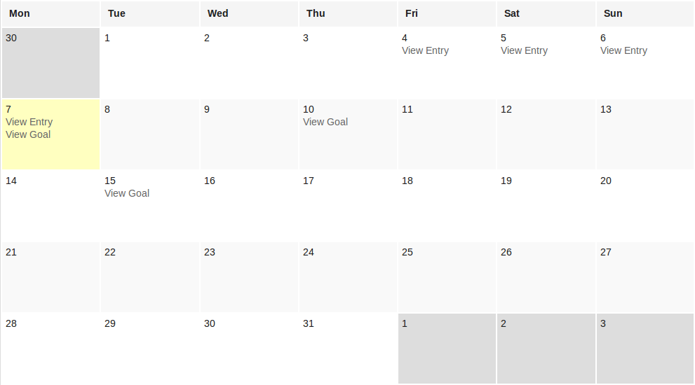
SimpleCalendar Sample Code
<%= month_calendar events: @entries do |date, events| %> <%= date.mday %> <% events.each do |event| %> <%= link_to event.title, event %> <% end %> <% end %>

Slide 10
Architecture
Controller
- Application
- Home
- Goals
- Entries
Model
- User
- Goal
- Entry
View
- Layouts
- Home
- Users
- Goals
- Entries

Slide 11
Users
Type | Name
string | email
string | encrypted-password
string | first_name
string | last_name
string | reset_password_token
datetime | reset_password_sent_at
datetime | remember_created_at
integer | sign_in_count
datetime | current_sign_in_at
datetime | last_sign_in_at
string | current_sign_in_ip
string | last_sign_in_ip
datetime | created_at
datetime | updated_at
Automatically created by Devise
Views
Sign Up
Login
Model
has_many :entries
has_many :goals

Slide 12
Goals
Type | Name
string | metric
float | value
date | by_date
date | created_at
date | updated_at
integer | user_id
Views
View All Goals
View Single Goal
Add Goal
Edit Goals
Model
belongs_to :user

Slide 13
Entries
Type | Name
integer | user_id
date | date
float | weight
integer | calories
string | workout
integer | energy
integer | sleep
datetime | created_at
datetime | updated_at
float | chest
float | waist
float | bicep
float | thigh
float | calf
Views
View All Entries
Calendar
List
View Single Entry
Add Entry
Edit Entry
View Progress
Model
belongs_to :user

Slide 14
Day 2 – User Side & Demo
Client Side
Sign Up/Login
Goals
Entries
Progress
Demo

Slide 15
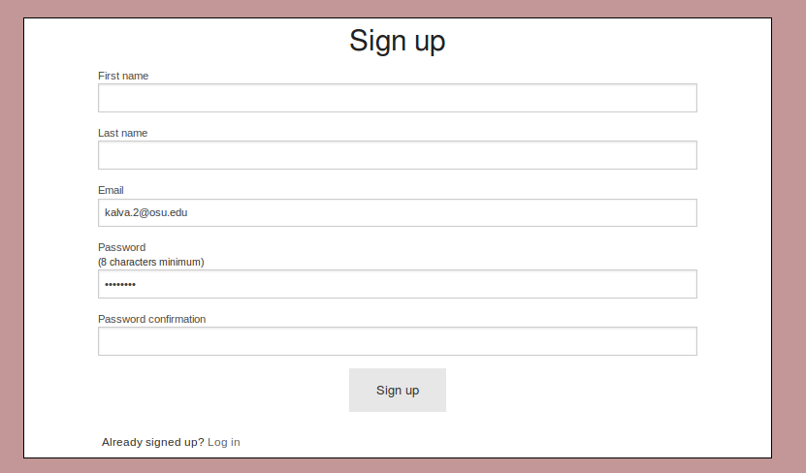
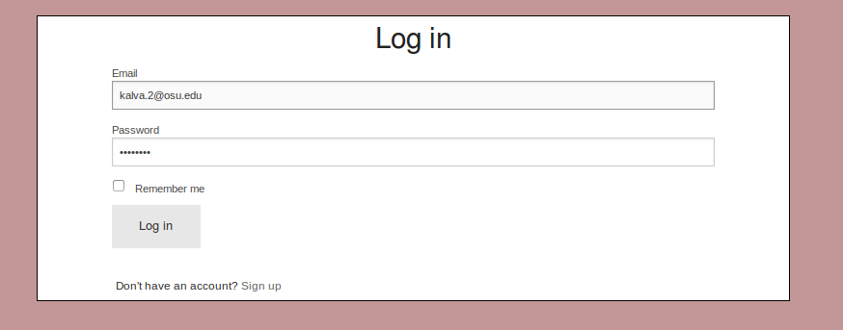
Signup/Login
Users can either sign up or login in using credentials

Slide 16
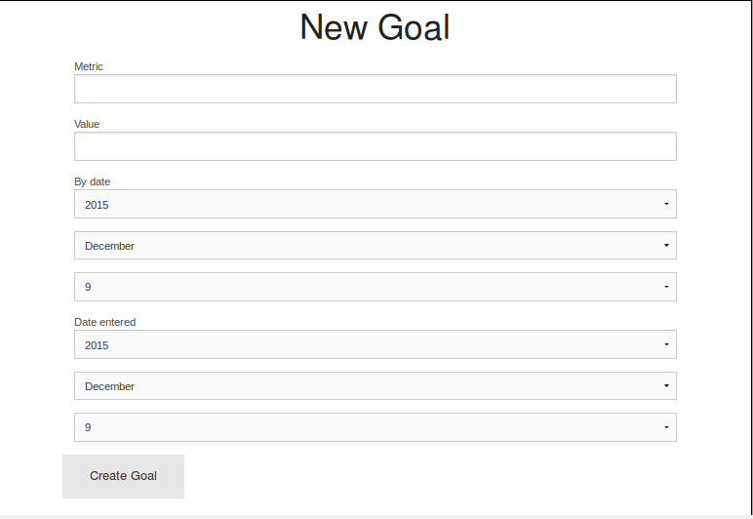
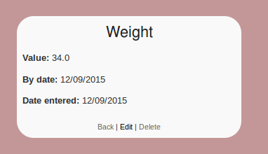
Goals
Metrics and goal date are used to create goals
Users can create, view, update, and delete their goals

Slide 17
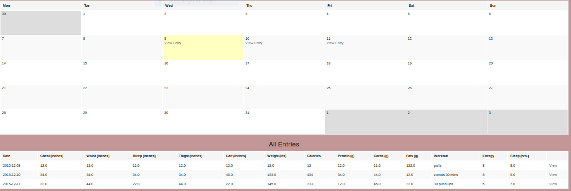
Entries
New Entry allows users to enter information for each day
Each entry can be saved, edited, or deleted
All entries are displayed on the main page for Entries

Slide 18
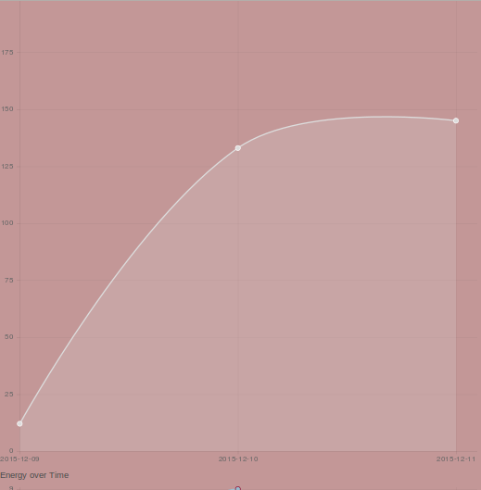
Progress
Used Chart.js
Four main charts include Weight, Calories, Energy, and Sleep
Graphs get updated after each new entry

Slide 19
Demo

